Slide 1
Advanced Hibernate Framework
Course
Java programming
Trainer
Designed by
To Chau
Last updated
Jul 25, 2011

Slide 2
Objectives
This course provides attendees a deeply knowledge of Hibernate techniques and share some tips or experiences.

Slide 3
Contents
Advance Hibernate mapping
Object States
Hibernate Session and Session Cache
Lazy Loading in Hibernate
Tips or troubles shooting experiences
References
Q&A

Slide 4
1. Advanced Hibernate Id mapping
Some commonly used generators in hibernate:
Class | Description | Types
assigned | lets the application assign an identifier to the object before save() is called. This is the default strategy if no <generator> element is specified. | Any supported type
foreign | uses the identifier of another associated object. It is usually used in conjunction with a <one-to-one> primary key association. | Any supported type
guid | uses a database-generated GUID string on MS SQL Server and MySQL. | 16 character ASCII string

Slide 5
1. Advanced Hibernate Id mapping
hilo | uses a hi/lo algorithm to efficiently generate identifiers of type long, short or int, given a table and column (by default hibernate_unique_key and next_hi respectively) as a source of hi values. The hi/lo algorithm generates identifiers that are unique only for a particular database. | long, short, int
identity | supports identity columns in DB2, MySQL, MS SQL Server, Sybase and HypersonicSQL. | long, short, int
increment | generates identifiers of type long, short or int that are unique only when no other process is inserting data into the same table. Do not use in a cluster. | long, short, int
native | selects identity, sequence or hilo depending upon the capabilities of the underlying database. | long, short, int

Slide 6
1. Advanced Hibernate Id mapping
select | retrieves a primary key, assigned by a database trigger, by selecting the row by some unique key and retrieving the primary key value. | Any supported type
seqhilo | uses a hi/lo algorithm to efficiently generate identifiers of type long, short or int, given a named database sequence. | long, short, int
sequence | uses a sequence in DB2, PostgreSQL, Oracle, SAP DB, McKoi or a generator in Interbase. | long, short, int
uuid | Generates a 128-bit UUID based on a custom algorithm. The value generated is represented as a string of 32 hexidecimal digits. | 32 digit hex string

Slide 7
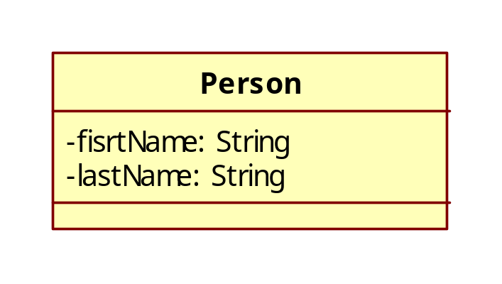
1. Advanced Hibernate Id mapping
Exercise:

Slide 8
1. Advanced Hibernate Id mapping
Foreign key identification mapping
<id name="id">
<generator class="foreign">
<param name="property">person</param>
</generator>
</id>
<one-to-one name="person" class="Person" constrained="true" />

Slide 9
1. Advanced Hibernate Id mapping
User type definition mapping
<hibernate-mapping package="model">
<typedef name="gender" class="util.EnumUserType">
<param name="enumClassName">model.Gender</param>
</typedef>
<class name="Person">
..........
<property name="gender" type="gender" />
...........
</class>
</hibernate-mapping>

Slide 10
1. Advanced Hibernate Id mapping
Composite identification mapping
<class name="Address">
<composite-id>
<key-property name="street"></key-property>
<key-property name="ward"></key-property>
<key-property name="district"></key-property>
</composite-id>
..........
</class>

Slide 11
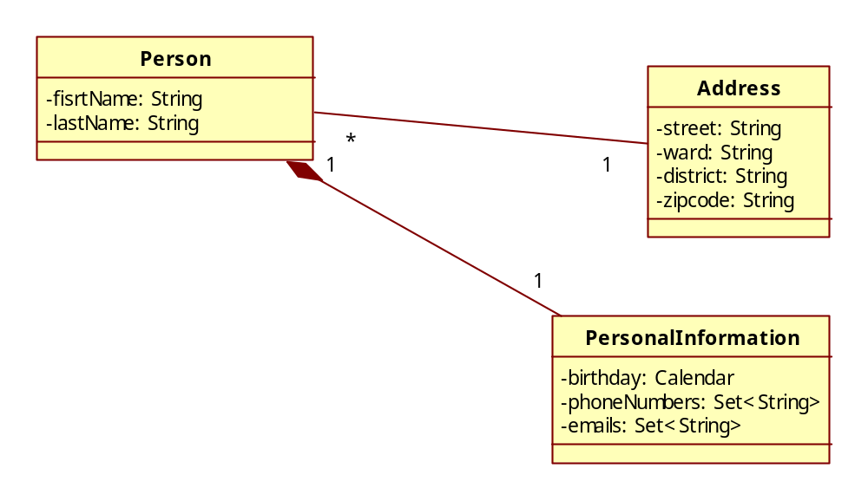
1. Advanced Hibernate Id mapping
Exercise:

Slide 12
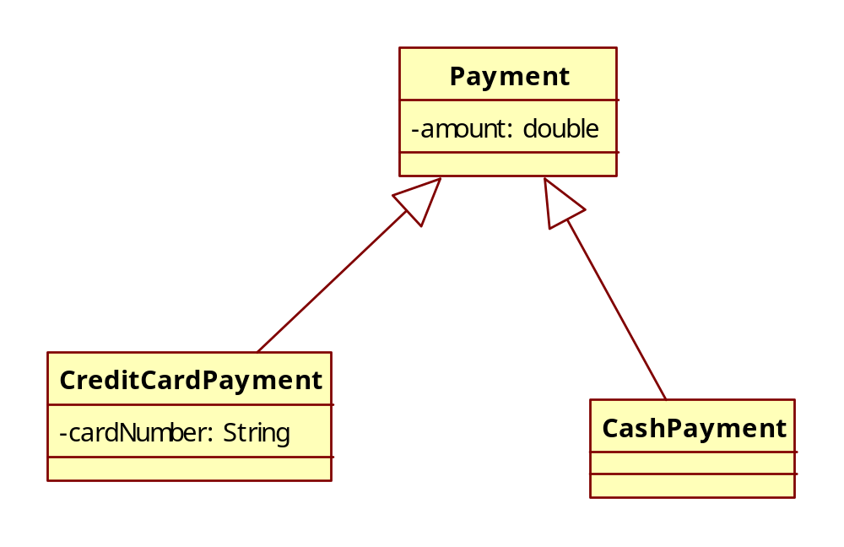
1. Advanced Hibernate mapping
Inheritance strategy mapping:

Slide 13
1. Advance Hibernate mapping
All in one
<class name="Payment">
  <id name="id" column="PAYMENTID">
  <generator class="native"></generator>
  </id>
  <discriminator column="PAYMENT_TYPE" type="string"></discriminator>
  <property name="amount"></property>
  <subclass name="CreditCardPayment" discriminator-value="CREDIT">
  <property name="cardNumber"></property>
  </subclass>
  <subclass name="CashPayment" discriminator-value="CASH">
  </subclass>
</class>

Slide 14
1. Advanced Hibernate mapping
Table per concrete class
<class name="Payment" abstract="true" >
<id name="id" >
<generator class="assigned" ></generator>
</id>
<property name="amount" />
<union-subclass name="CreditCardPayment" >
<property name="cardNumber" />
</union-subclass>
<union-subclass name="CashPayment" >
</union-subclass>
</class>

Slide 15
1. Advanced Hibernate mapping
Table per subclass
<class name="Payment">
<id name="id" column="PAYMENTID">
<generator class="native"></generator>
</id>
<joined-subclass name="CreditCardPayment“ table="CREDIT_PAYMENT">
<key column="PAYMENTID"></key>
<property name="cardNumber"></property>
</joined-subclass>
<joined-subclass name="CashPayment" table="CASHPAYMENT">
<key column="PAYMENTID"></key>
</joined-subclass>
</class>

Slide 16
2. Object States
Object states: each state represents model object relationship with Hibernate Session. There are 3 states:
  Transient: new object, not stored in DB or Id =0 and no associated session
  Persisted: object presents a row in DB (opened session)‏
  Detached: object presents a row in DB but session closed

Slide 17
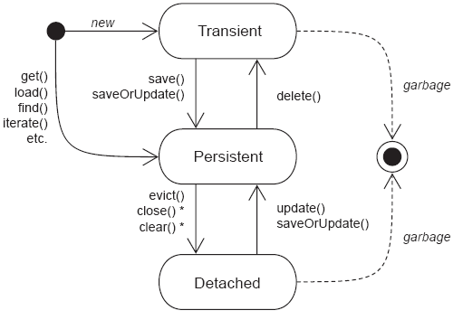
2. Object States

Slide 18
2. Object States
SaveOrUpdate function:
  Not put data into DB
  Update session in-memory state
  Transient object: associate/attach object to current session (get new Id)‏
  Persisted object: do nothing (already in session)‏
  Detached object: re-associate/re-attach object to current session

Slide 19
3. Hibernate Session
3.1 Hibernate Session
Get way/ connection to DB
All queries are executed in a session
Begin unit of work → open a session
End unit of work → close session
Close session: synchronize in-memory session state into DB

Slide 20
3. Hibernate Session
3.2 Session Scope: short conversations
To begin a unit of work you open a Session. To end a unit of work you close a Session.
Most common programming model: session-per-request
Request
Response
S1
T1

Slide 21
3. Hibernate Session
3.2 Session Scope (cont.): long conversations model
Multi dialogs/pages
Many requests/responses
session-per-request-with-detached-objects pattern:
  Persisted objects → detached from session when closed (user think-time)‏
  Detached objects → re-attached to new session when modified

Slide 22
3. Hibernate Session
3.2 Session Scope (cont.): long conversations model
Conversation
Detached Objects
saveOrUpdate()
merge()‏
Request
Response
Request
Response
S1
S2
T1
T2
myDetail.do
Show page
Save page
redirect page

Slide 23
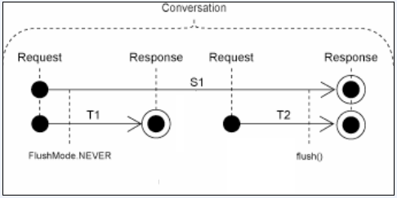
3. Hibernate Session
3.2 Session Scope (cont.): long conversations model
session-per-conversation pattern:

Slide 24
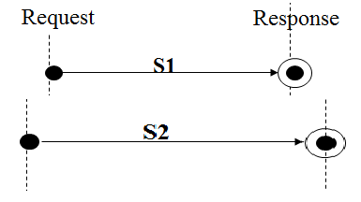
4. Optimistic concurrency

Slide 25
4. Optimistic concurrency
Version
<version name="version"></version>

Slide 26
4. Optimistic concurrency
Timestamp
<timestamp name="timestamps" ></timestamp>

Slide 27
5. Session Cache
To improve performance
Avoid the overhead of retrieving objects from the database each time.
Object will be cached in Session cache when:
  Pass object to: save(), update(),saveOrUpdate()‏
  Access object with: load(),find(),filter(),iterate()‏
Session.flush(): synchronize object state in Session cache to Database.

Slide 28
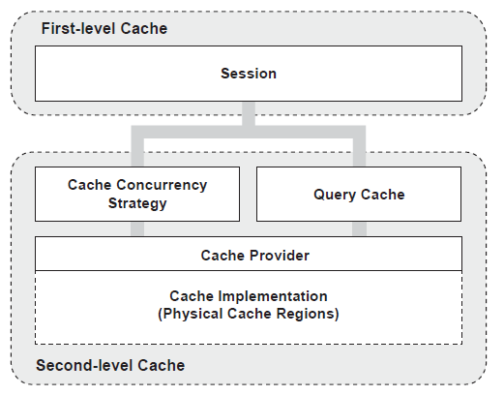
5. Session Cache

Slide 29
5. Session Cache
First-level cache
  The first-level cache is the Session itself.
  Hibernate uses this cache by default.
  Mainly it reduces the number of SQL queries it needs to generate within a given transaction.
  That is instead of updating after every modification done in the transaction, it updates the transaction only at the end of the transaction.

Slide 30
5. Session Cache
  Second-level cache always associates with the Session Factory object.

Slide 31
5. Session Cache
EHCache (Easy Hibernate Cache) (org.hibernate.cache.EhCacheProvider)‏
  It is fast.
  lightweight.
  Easy-to-use.
  Supports read-only and read/write caching.
  Supports memory-based and disk-based caching.
  Does not support clustering

Slide 32
5. Session Cache
OSCache (Open Symphony Cache) (org.hibernate.cache.OSCacheProvider)
  It is a powerful .
  flexible package
  supports read-only and read/write caching.
  Supports memory- based and disk-based caching.
  Provides basic support for clustering via either JavaGroups or JMS.

Slide 33
5. Session Cache
SwarmCache (org.hibernate.cache.SwarmCacheProvider)
  is a cluster-based caching.
  supports read-only or nonstrict read/write caching .
  appropriate for applications those have more read operations than write operations.

Slide 34
5. Session Cache - Caching Strategies
Read-only
  Useful for data that is read frequently but never updated.
  It is Simple .
  Best performer among the all.
  Advantage if this one is, It is safe for using in a cluster

Slide 35
5. Session Cache - Caching Strategies
Read-Write
  Used when our data needs to be updated.
  It’s having more overhead than read-only caches.
  Maintains read committed isolation, using a timestamping mechanism.
  It’s available only in non-clustered environments. Again, use this strategy for read-mostly data where it’s critical to prevent stale data in
  concurrent transactions, in the rare case of an update.

Slide 36
5. Session Cache - Caching Strategies
Nonstrict read-write
  Needed if the application needs to update data rarely.
  Makes no guarantee of consistency between the cache and the database.
  If there is a possibility of concurrent access to the same entity, you should configure a sufficiently short expiry timeout.

Slide 37
5. Session Cache - Caching Strategies
Transactional
  It supports only transactional cache providers such as JBoss TreeCache.
  Available in a managed environment only. It guarantees full transactional isolation up to repeatable read, if required.
  Use this strategy for read-mostly data where it’s critical to prevent stale data in concurrent transactions, in the rare case of an update.

Slide 38
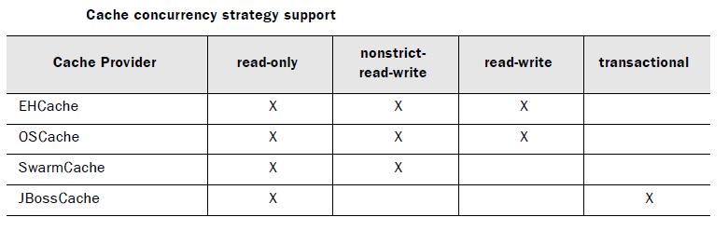
5. Session Cache - Caching Strategies

Slide 39
5. Session Cache - Caching Strategies
Session cache management:
  Session.contains(): to see whether an object is contained in the Session cache.
  Session.evict(): to evict objects from the cache.
  Session.clear(): to clear all the objects from the Session cache.

Slide 40
6. Lazy Loading in Hibernate
Only load data when needed( accessed)‏
Prevent loading unnecessary information
Improve performance
<hibernate-mapping> <class name="Category" table="CATEGORY"> ... <set name="items" table="CATEGORY_ITEM" lazy="true" > <key column="CATEGORY_ID"/> <many-to-many class="Item" column="ITEM_ID"/> </set> </class> </hibernate-mapping>

Slide 41
7. Tips/troubles shooting experiences
7.1 Lazy Loading Exception
If you close the session and try to access an uninitialized collection, Hibernate throws a runtime exception.
Session session = sessions.openSession(); Transaction tx = session.beginTransaction(); Category cat = (Category) session.get(Category.class, id); tx.commit(); session.close(); Iterator iter = cat.getItems().iterator(); // throws exception

Slide 42
7. Tips/troubles shooting experiences
7.1 Lazy Loading Exception (cont.)‏
cat: detached object
Request
Response
Request
Response
S1
S2
cat=getCategory()‏
cat.getItems() → Exception
Fix2 = Hibernate.initialize( cat.getItems())‏
Fix1 = saveOrUpdate(cat)‏

Slide 43
7. Tips/troubles shooting experiences
7.2 NonUniqueObjectException
Message: a different object with the same identifier value was already associated with the session:
Note: Only one object instant in a Hibernate Session

Slide 44
7. Tips/troubles shooting experiences
7.2 NonUniqueObjectException (cont.)‏
P1: detached object
Request
Response
Request
Response
S1
S2
P1=getPerson()‏
P2=getPerson()‏
saveOrUpdate(P1) → Exception

Slide 45
7. Tips/troubles shooting experiences
7.2 NonUniqueObjectException (cont.)‏
Fix1: use merge(P1) instead of saveOrUpdate(P1) → P1 will replace P2. So, it is not good solution.
Fix2: set modified data into P2 and then saveOrUpdate(P2) instead of P1.

Slide 46
References
http://www.hibernate.org
http://www.roseindia.net/hibernate/index.shtml
http://www.hibernate.org/hib_docs/reference/en/html/index.html

Slide 47
Document Revision History
Date | Version | Description | Revised by
13 Sep 2011 | 1.0 | First version | To Chau
Notes:
If your document based on this template is a document that is required to control the version, you must keep this slide and fill information related to version control and fill in the fields : Owner, Reviewers, Approver, Issue date, Issue status, Document location (menu File -> Properties -> tab Custom)

